Slide 1

HDMA Washington Home Loans Prediction

Slide 2
Overview
This project is divided into 4 parts
Data Wrangling – Methods used to transform data into statistical usable format
Data Story – Visual insights into data
EDA – A hypothesis test to analyze bias and correlation
Prediction model – Machine learning algorithms used and methods applied to predict the model
Conclusion – Findings of the Machine learning models

Slide 3
Introduction
The Home Mortgage Disclosure Act (HMDA) requires many financial institutions to maintain, report, and publicly disclose information about mortgages. The project uses this data to make loan approval predictions.
Data is at https://www.kaggle.com/miker400/washington-state-home-mortgage-hdma2016/home
This project builds prediction model to help bank make data driven decisions and features affecting loan approval.
This project is divided into three parts Data Wrangling, EDA and Prediction Model.

Slide 4
Data Wrangling
Following data cleaning methods are used
Drop Columns - Columns with few data elements are dropped
Column Data Types – Data type of Columns with categorical data is changed to “Category”
Missing Data – Columns having around 90% of “NaN” values are dropped, since there were 11 columns with less than 90% data and also imputed values cause bias in data. Columns having fewer missing values(2%) of “NaN” data are imputed to median values and values based on other column values.
For ex - Substitute missing values in msamd_name with value based on value in census_tract_number
Outliers - Outliers are visually inspected with box plots and filtered out

Slide 5
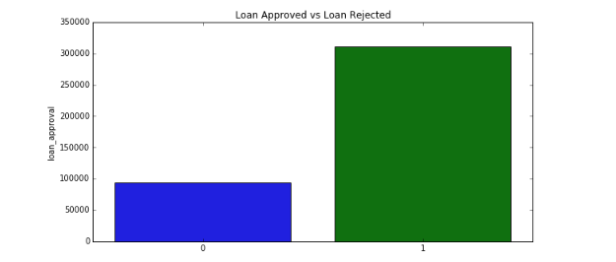
Data Story
There are 310593 loan approved applications and 93595 loans rejected. Data is not a balanced data.

Slide 6
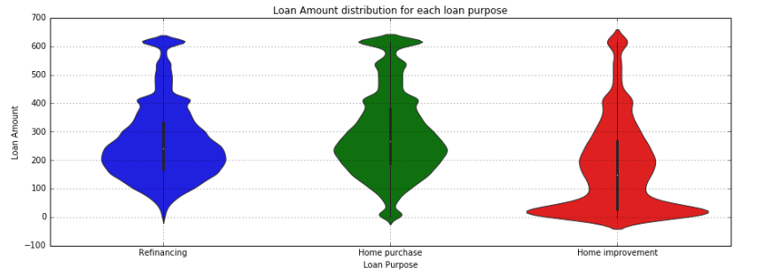
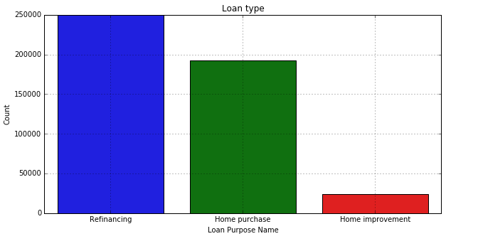
Data Story
Distribution of loan amounts are between 150K to 300K across all the Metropolitan areas, loan purpose and action taken.
53% of the loans applications are Refinancing, 40% are for Home Purchase and 7% are for Home Improvement.

Slide 7
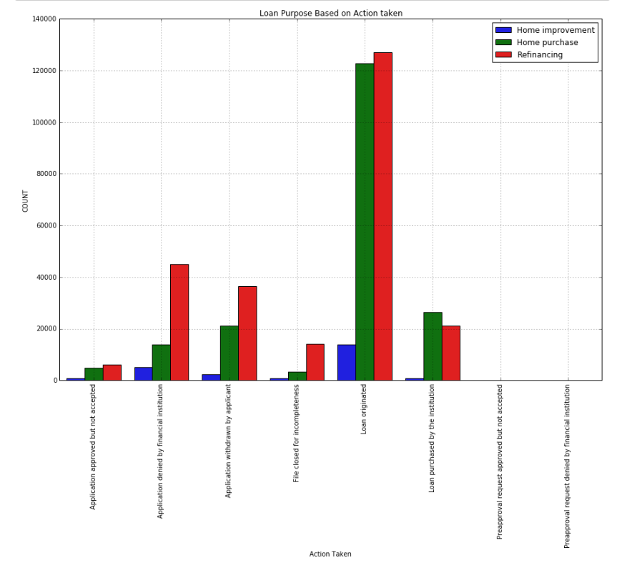
Data Story
Approximately 40% of the loans are approved in each loan purpose Home purchase and Refinancing, and 20% for Home Improvement.

Slide 8
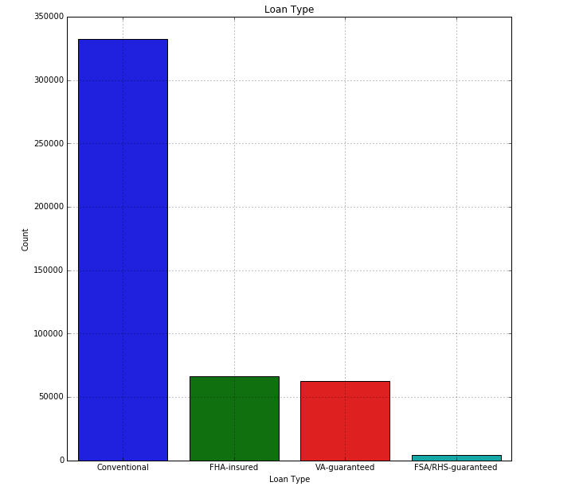
Data Story
Approximately 70% of the loans applications are Conventional loan type.

Slide 9
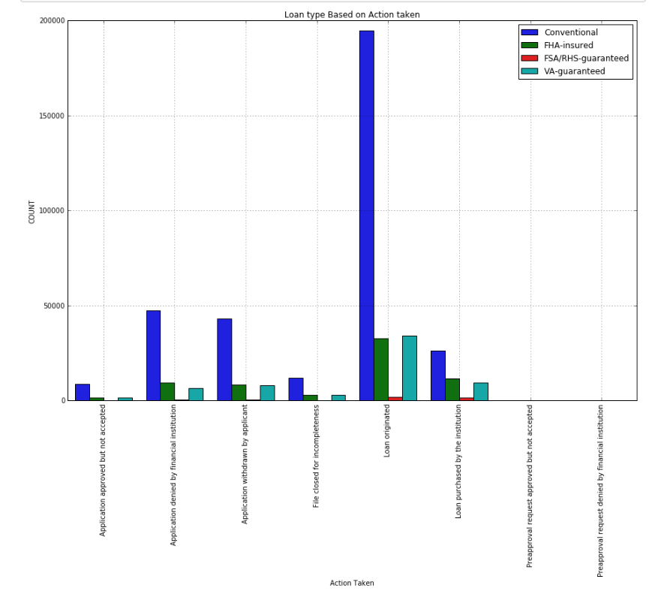
Data Story
Approximately 60% of the loans approved are Conventional loans.

Slide 10
EDA
Gender Bias
A hypothesis test was conducted to determine Gender bias.
With a t-statistic value 7.83 and P-value 5.10, failed to reject null hypothesis and determined that there is a gender bias in loan approval.
Racial Bias
A Hypothesis test was defined to evaluate if there is racial bias between ‘Not Hispanic or Latino’ and ‘Hispanic or Latnio’.
After calculating t-statistic value 16.62 and P-value 0, it was determined that there is no racial bias in loan approval.

Slide 11
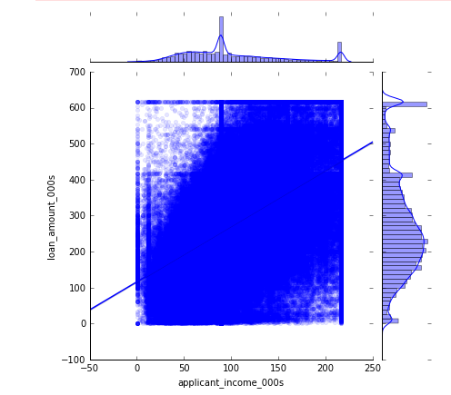
EDA
Correlation Between Loan Amount and Applicant Income
Pearson correlation coefficient 0.55 was calculated using np.corrcoef() and a hypothesis test was calculated to test the correlation coefficient.
A t-statistic 460.16, confidence interval (-3.48, 3.48) and P-value 0, was calculated and determined that there was a low chance of getting the observed correlation coefficient.
However scatter plot does show some positive correlation between loan amount and applicant income.

Slide 12
Prediction Model
Four models are used for loan approval prediction
Logistic Regression from SKLearn
GLM and Logistic Regression from StatsModels
Random Forest
XGBOOST
Data will be trained and tested on all the above four algorithms. Model will be evaluated by calculating
Accuracy score
Precision and Recall
Confusion matrix
ROC Area

Slide 13
Prediction Model - Logistic Regression using SKLearn
Split data for training and testing with all the features.
Recursive Feature elimination(RFE) method is used for feature selection.
After find most important features from RFE, again split data for train and test based on features selected.
Second split data for tuning hyperparameter C using GridSearchCV and C value of 10 was obtained.
Confusion Matrix and Precision and Recall is computed for determining accuracy.
Above steps are repeated for all 25 features by eliminating one at a time

Slide 14
Prediction Model - Logistic Regression using SKLearn
Test data
Training data
Precision and Recall
Precision and Recall
class | precision | recall | f1-score | support
0 | 0.77 | 0.77 | 0.77 | 18723
1 | 0.93 | 0.93 | 0.93 | 62115
class | precision | recall | f1-score | support
0 | 0.78 | 0.77 | 0.77 | 18723
1 | 0.93 | 0.93 | 0.93 | 62115
Confusion Matrix
Confusion Matrix
 | Predicted 0 | Predicted 1
Actual 0 | 14377 | 4346
Actual 1 | 4203 | 57912
 | Predicted 0 | Predicted 1
Actual 0 | 57378 | 17494
Actual 1 | 16410 | 232068
Accuracy Score : 89.42
Area Under curve score : 0.89424
Accuracy Score : 89.51
Area Under curve score : 0.95682

Slide 15
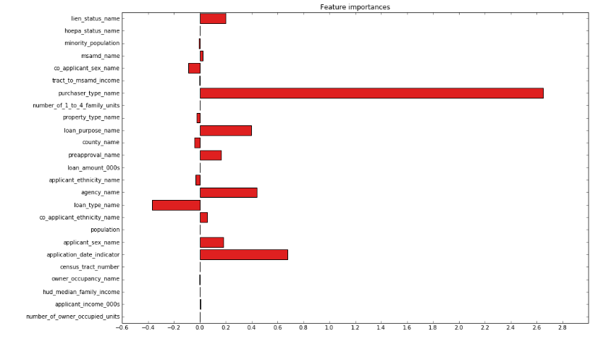
Prediction Model - Logistic Regression using SKLearn
Feature Importance

Slide 16
Prediction Model – Logit and GLM using stats model
Both logit and GLM yield same result.
Precision and recall
Confusion matrix
Test data
Training data
Precision and Recall
class | precision | recall | f1-score | support
0 | 0.74 | 0.83 | 0.79 | 18723
1 | 0.95 | 0.91 | 0.93 | 62115
class | precision | recall | f1-score | support
0 | 0.75 | 0.84 | 0.79 | 18723
1 | 0.95 | 0.92 | 0.93 | 62115
Confusion Matrix
 | Predicted 0 | Predicted 1
Actual 0 | 15624 | 3099
Actual 1 | 5350 | 56765
 | Predicted 0 | Predicted 1
Actual 0 | 62523 | 12349
Actual 1 | 21113 | 227365
Accuracy Score : 89.55
Area Under curve score : 0.95870
Accuracy Score : 89.65
Area Under curve score : 0.95933

Slide 17
Prediction Model – Random Forest
In this model hyperparameters are tuned using RandomizedSearchCV. Hyperparameters found in RandomizedSearchCV are used to for learning RandomForestClassifier. This model is tested on test data and evaluated using accuracy, precision and recall, and confusion matrix.
Hyperparameters tuning
n_estimators - the number of trees in the forest. Usually higher number of trees the better to learn the data. n_estimators = [4, 8, 16, 32, 64, 100, 200]
max_features - number of features to consider when looking for the best split. max_features = [2, 4, 5, 10, 15, 20, 25]
max_depth - depth of the tree, the more splits it has and it captures more information about the data. But as the tree gets very deep, it might lead to overfitting. max_depth - [4, 8, 10, 12, 16, 32, 64]

Slide 18
Prediction Model – Random Forest
Hyperparameters tuning continued ….
min_samples_split - number of samples required to split an internal node. smaller samples might lead to overfitting. min_samples_split = [2, 4, 6, 8, 10, 12, 16, 32, 64]
min_samples_leaf - The minimum number of samples required to be at a leaf node. smaller samples might lead to overfitting. min_samples_leaf = [2, 4, 6, 8, 10, 12, 16, 32, 64]
criterion - ['gini','entropy']
bootstrap - [True, False]
Best Parameters are n_estimators – 200, max_features - 10, max_depth - 12, min_samples_split - 4, min_samples_leaf - 8, criterion - gini, bootstrap - False

Slide 19
Prediction Model – Random Forest
Test data
Training data
Precision and recall
Precision and recall
class | precision | recall | f1-score | support
0 | 0.80 | 0.83 | 0.81 | 18723
1 | 0.95 | 0.94 | 0.94 | 62115
class | precision | recall | f1-score | support
0 | 0.80 | 0.84 | 0.82 | 18723
1 | 0.95 | 0.94 | 0.95 | 62115
Confusion Matrix
Confusion Matrix
 | Predicted 0 | Predicted 1
Actual 0 | 15609 | 3114
Actual 1 | 3994 | 58121
 | Predicted 0 | Predicted 1
Actual 0 | 63157 | 11715
Actual 1 | 15318 | 233160
Accuracy Score : 91.21
Area Under curve score : 0.97015
Accuracy Score : 91.64
Area Under curve score : 0.97363

Slide 20
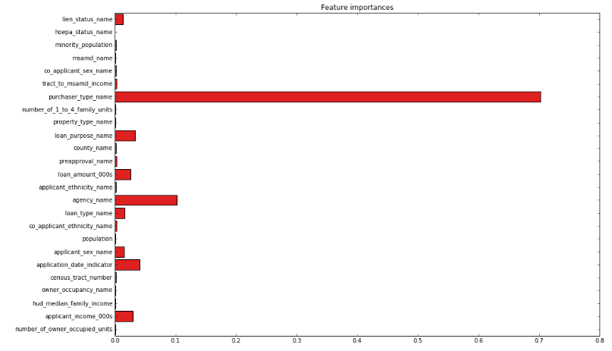
Prediction Model – Random Forest
Feature Importance

Slide 21
Prediction Model – XGBOOST
In this model hyperparameters are tuned using RandomizedSearchCV. Hyperparameters found in RandomizedSearchCV are used to for learning XGBClassifier. This model is tested on test data and evaluate using precision and recall, and confusion matrix.
Hyperparameters Tuning
n_estimators - number of trees to grow. Larger the tree size better the model, but more numbers of trees can be computationally expensive and affects the performance of the model n_estimators = [4, 8, 16, 32, 64, 100, 200]
max_depth - depth of the tree, the more splits it has and it captures more information about the data. But as the tree gets very deep, it might lead to overfitting max_depth = [4, 8, 10, 12, 16, 32, 64]

Slide 22
Prediction Model – XGBOOST
Hyperparameters Tuning continued….
min_child_weight - Minimum sum of instance weight needed in a child. min_child_weight = [2, 4, 6, 8, 10, 12, 16, 32, 64]
gamma - [0.1, 0.2, 0.3, 0.4, 0.5]
colsample_bytree - Subsample ratio of columns when constructing each tree. colsample_bytree = [0.2, 0.4, 0.6, 0.8]
colsample_bylevel - Subsample ratio of columns for each split, in each level colsample_bylevel = [0.2, 0.4, 0.6, 0.8]
Best Parameters are n_estimators - 64, max_depth - 32, min_child_weight - 64, gamma – 0.3, colsample_bytree- 0.8, colsample_bylevel – 0.2

Slide 23
Prediction Model – XGBOOST
Test data
Training data
Precision and recall
Precision and recall
class | precision | recall | f1-score | support
0 | 0.80 | 0.83 | 0.82 | 18723
1 | 0.95 | 0.94 | 0.94 | 62115
class | precision | recall | f1-score | support
0 | 0.81 | 0.85 | 0.83 | 18723
1 | 0.95 | 0.94 | 0.95 | 62115
Confusion Matrix
Confusion Matrix
 | Predicted 0 | Predicted 1
Actual 0 | 15621 | 3102
Actual 1 | 3889 | 58226
 | Predicted 0 | Predicted 1
Actual 0 | 63644 | 11228
Actual 1 | 14538 | 233940
Accuracy Score : 91.35
Area Under curve score : 0.97056
Accuracy Score : 92.03
Area Under curve score : 0.97434

Slide 24
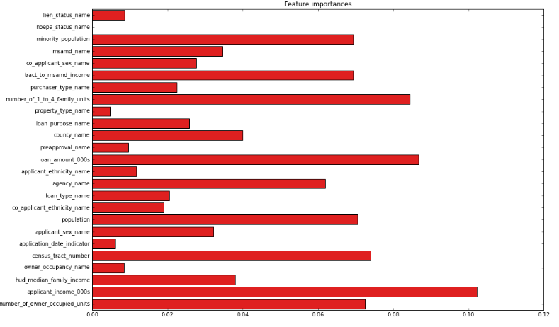
Prediction Model – XGBOOST
Feature Importance

Slide 25
Conclusion
Among all the four models, XGBOOST and Random Forest do better than other models. XGBOOST and Random Forest both have almost same precision and recall. XGBOOST is 1% better(F1-Score) at predicting loan rejection rate than Random Forest.

